Slide 1
Nicholas Grogg
Program 4 Plan

Slide 2
Overview
Program based on previous work
Linked List
Program 1
Inheritance
Dynamic and flexible

Slide 3
Classes
Employee class
Hourly employee
Salaried employee
Temp slave employee
Executive class

Slide 4
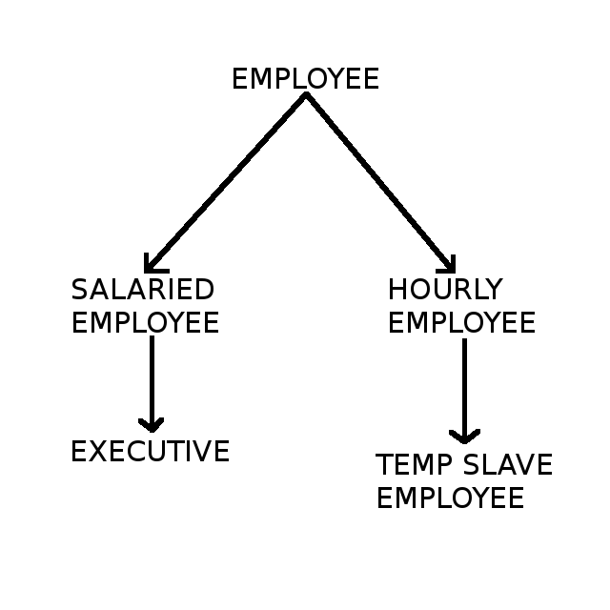
Classes (visualized)

Slide 5
Program format (part 1)
Each class will have a linked list
Created at runtime
Empty list by default
User can use menu to manipulate program
Add, remove, edit, output employees
Won't need unusual functions

Slide 6
Program format (part 2)
Menu will be based on program 1
Use numbers and if statements
Examples
1 Add an employee
Input data, create a node in correct list
42 Not a command
Output invalid command

Slide 7
Menu commands
1, Add employee
2, Modify employee data
3, Output employee data
4, Delete an employee
5, Output payroll to console
6, Output payroll to text file
7, quit

Slide 8
Functions
All functions from HRM.cpp program
Linked list functions
Add item
Search for item
Output list
Remove item
Overloaded >> and << operators

Slide 9
Variables
All variables from HRM.cpp program
Ints for menu program
Variables for Executive and Temp-Slave
Variable for Salaried employee grade
Bool for program while loop

